Slide 1
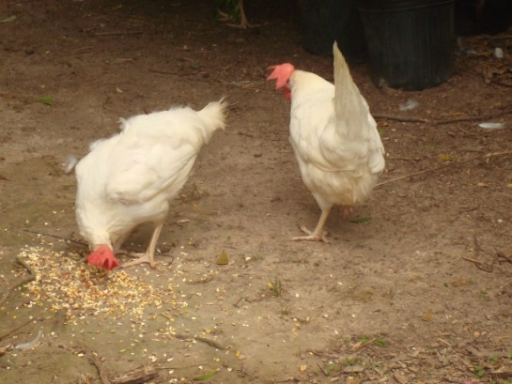
Backyard Chickens and Birds
Lillie Howard
2018 Fall Garden Workshop

Slide 2
Urban Agriculture
In 2011, the U.S. Environmental Protection Agency (EPA) released the Urban Farm Business Plan Handbook (Handbook) to provide guidance for developing a business plan for the startup and operation of an urban farm. While the Handbook acknowledged aquaponics as a method of producing food in an urban environment, the Handbook generally focused on food and non-food related cultivated agriculture

Slide 3
“If the people let government
decide what foods they eat and what medicines they take, their bodies will soon be in as sorry a state as are the souls of those who live under tyranny”
Thomas Jefferson

Slide 4
Before you can feed you can feed someone else, you must be able to feed yourself. Dawn Mellion Patin

Slide 5
We just eat whatever is outside at that time of the year. We eat with the seasons as nature provides.
Milagro Berhane

Slide 6
Golden buffs & Australops
Dual Purpose Chickens

Slide 7
Broilers
Meat Birds

Slide 8
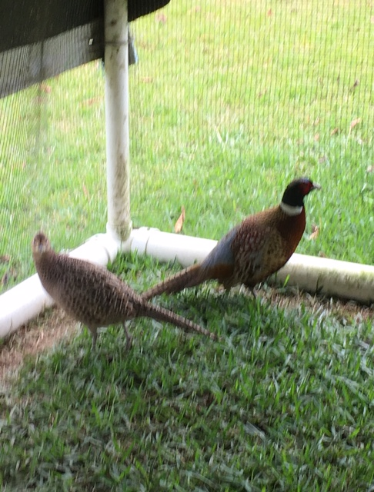
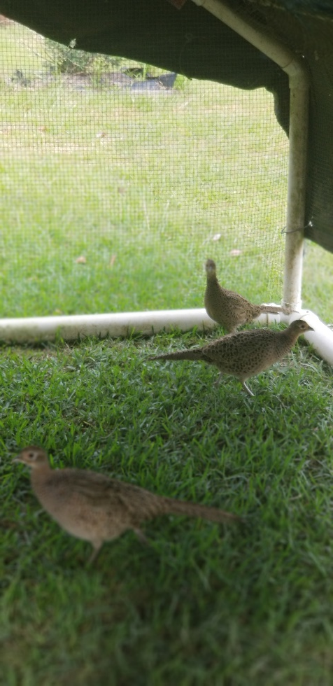
Ringneck pheasants

Slide 9
Guinea fowl

Slide 10
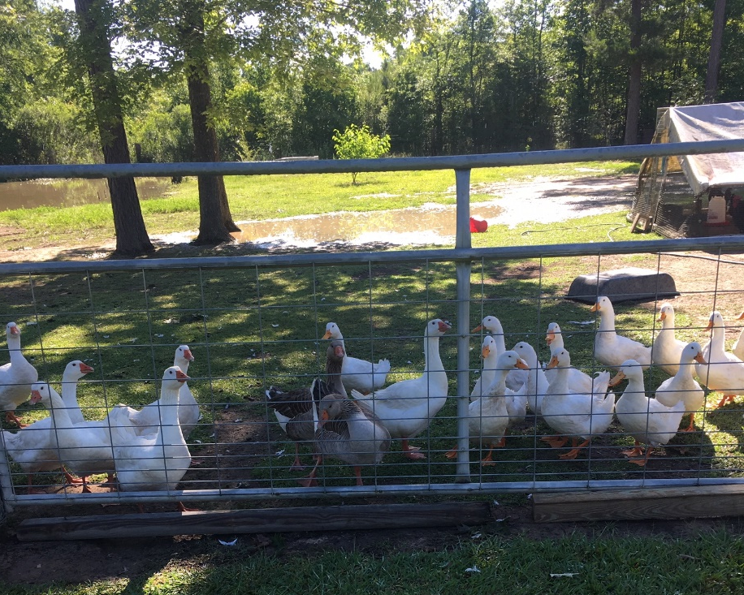
Ducks
and
Geese

Slide 11
Fresh water

Slide 12
Free ranging

Slide 13
Dust bath

Slide 14
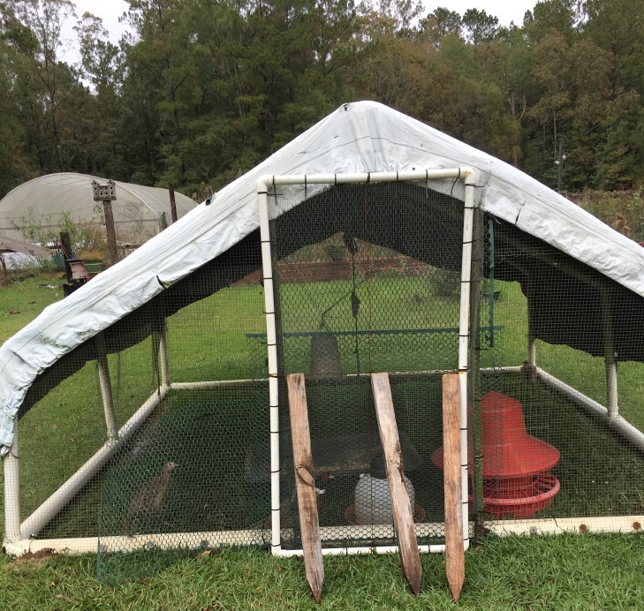
Portable Housing for Pheasant

Slide 15
Portable housing

Slide 16
Herbs for Chickens
Lavender
Oregano
Sage
Mint
Parsley

Slide 17
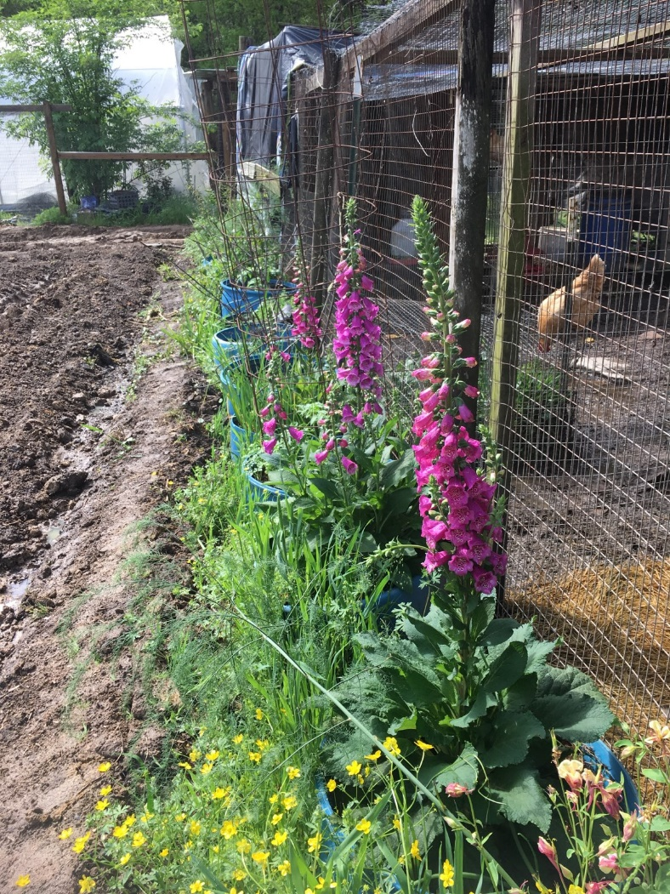
Creative vegetation for caged animals

