Slide 1
Breeds for Backyard Poultry
Felton DeRouen II
Southern University A&M
Land Grant Campus

Slide 2
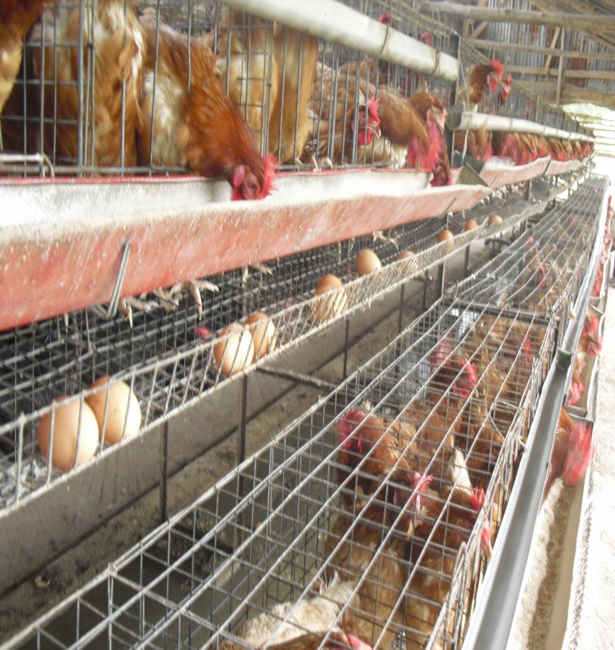
Types of Poultry (Production)
Broiler
Layer

Slide 3
Types of Poultry (Production)
Broilers
Layers
Meat Production
8 to 10 weeks for harvesting ( 8 weeks is norm.)
Egg Production
24 weeks (6 months) to begin laying eggs

Slide 4
Meat Producers
Cornish Cross
Jersey Giant

Slide 5
Meat Producers
Cornish Cross
Jersey Giant
Male (wt.) 12 lbs.
Female (wt.) 8 lbs.
Harvest time 4- 6 weeks
Pros & Cons
Fast growth
Lots of white meat
Eats a lot
Male (wt.) 13 lbs.
Female (wt.) 10 lbs.
Harvest time 16-21 weeks
Pros & Cons
Large
Slow growth

Slide 6
Meat Producers
Bresse
Freedom Ranger

Slide 7
Meat Producers
Bresse
Freedom Ranger
Male (wt.) 7 lbs.
Female (wt.) 5 lbs.
Harvest time 16-20 weeks
Pros & Cons
Docile
Tastes great
Not to meaty
Male (wt.) 6 lbs.
Female (wt.) 5 lbs.
Harvest time 9-11 weeks
Pros & Cons
Great for free range
Easy to Keep
Smaller and slower growth rate

Slide 8
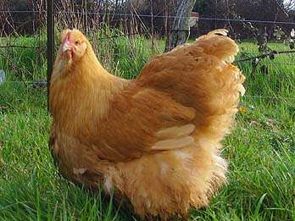
Dual Purpose Producer
Orpington
Brown Leghorn

Slide 9
Dual Purpose Producers
Orpington
Brown Leghorn
Male (wt.) 10 lbs.
Female (wt.) 8 lbs.
Harvest time 18-24 weeks
Egg production(annual) 190
Pros & Cons
Great egg layers
Docile
Slow growth
Male (wt.) 6 lbs.
Female (wt.) 5 lbs.
Harvest time 16- 21 weeks
Egg production(annual) 280
Pros & Cons
Forager
Good layer
Decent meat

Slide 10
Dual Purpose Producer
Egyptian Fayoumi
Turken (Naked Neck)

Slide 11
Dual Purpose Producer
Egyptain Fayoumi
Turken (Naked Neck)
Male (wt.) 5 lbs.
Female (wt.) 4 lbs.
Harvest time 14-18 weeks
Egg production (annual) 150
Pros & Cons
Fast growth
Taste great (Eggs and Meat)
Flighty
Male (wt.) 6 lbs.
Female (wt.) 4 lbs.
Harvest time 11-18 weeks
Egg production (annual) 104
Pros & Cons
Easy to keep
Decent egg and meat production

Slide 12
Egg Producer
White Leghorn
Rhode Island Red

Slide 13
Egg Producer
White Leghorn
Rhode Island Red
Egg production(annual) 280
Female (wt.) 5 lbs.
Start laying 16-17 weeks old
Temperament
Nervous
Flighty
Egg production(annual) 260
Female (wt.) 6.5 lbs.
Start laying 18-24 weeks old
Temperament
Hardy

Slide 14
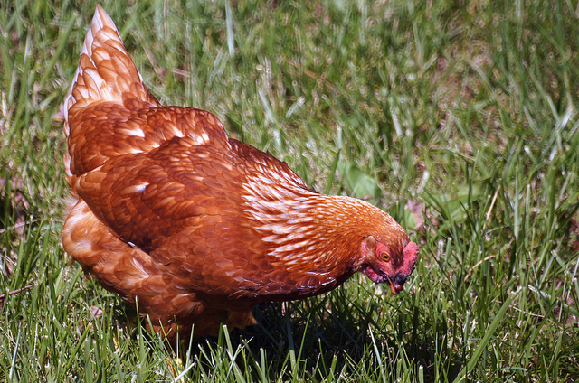
Egg Producer
Golden Comet
Ameraucana

Slide 15
Egg Producer
Golden Comet
Ameraucana
Egg production(annual) 250-300
Female (wt.) 5 – 7.5 lbs.
Start laying 15 weeks old
Temperament
Gentle
Quiet
Egg production(annual) 250
Female (wt.) 4.5 -5.5 lbs.
Start laying 25-30 weeks old
Temperament
Broody

Slide 16
Egg Producer
Barred Plymouth Rock
Golden Laced Wyandottes

Slide 17
Egg Producer
Barred Plymouth Rock
Golden Laced Wyandotte
Egg production(annual) 280
Female (wt.) 6.5 lbs
Start laying 18-22 weeks old
Temperament
Calm
Egg production(annual) 200
Female (wt.) 6 lbs.
Start laying 18-20 week old
Temperament
Docile

Slide 18
Egg Producer
Australorp
Egg production(annual) 250
Female (wt.) 5-7lbs.
Start laying 22-24 week old
Temperament
Hardy

Slide 19
When Choosing your Flock

