Slide 1
Non Traditional Fall Crops for South Louisiana Stephanie Elwood Extension Associate
Notes:
1

Slide 2
Fall Crops
carrots - turnip
cauliflower - radish
cabbage - beets
broccoli - lettuces
collard greens
mustard greens

Slide 3
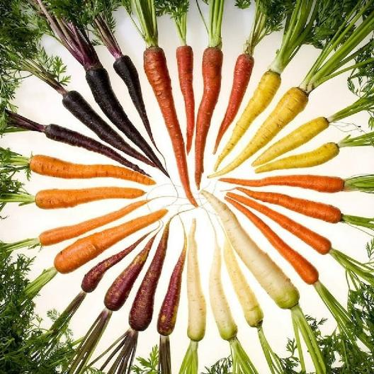

Slide 4
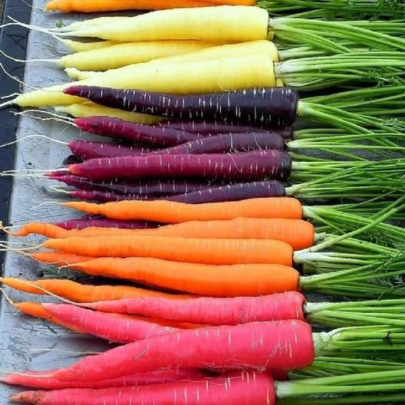
CARROTS
Rainbow
Purple haze

Slide 5
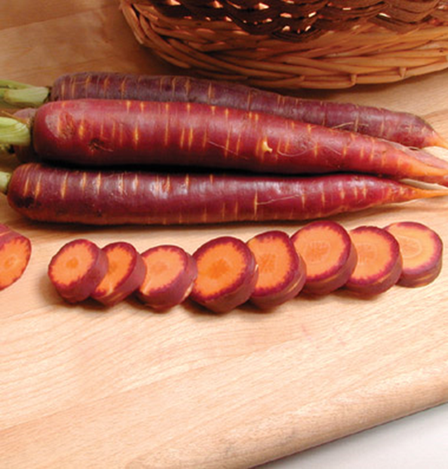

Slide 6
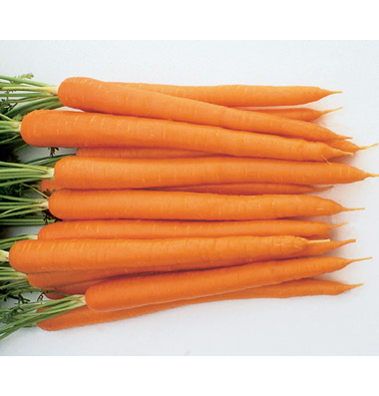
CARROTS
Sugar Snax
long slender roots
smooth uniform 9-10 inch
roots have strong med
sized tops.
hybrid
resistent to Alternaria blight

Slide 7
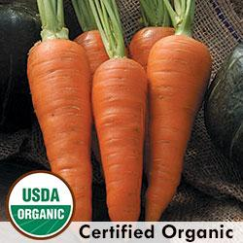
Danvers
Bright orange flesh is nearly coreless,
sweet, and tender. Uniform roots up to
8" long. High yields in clay or heavy soils.
65-87 days.

Slide 8
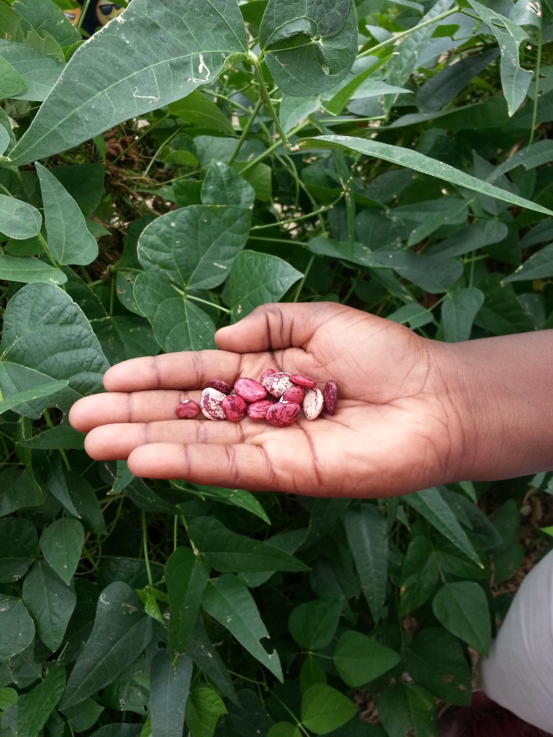
Planting methods
Direct seed
Transplants
Root crops

Slide 9
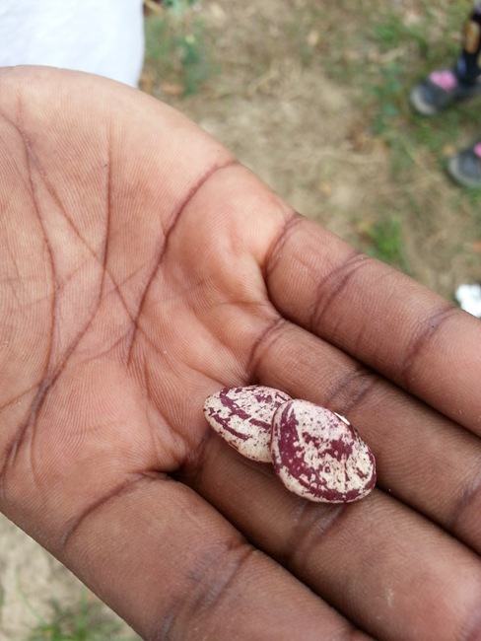
Seed Selection
Transplant more expensive seed
Less expensive seed direct seed
Get the good stuff

Slide 10
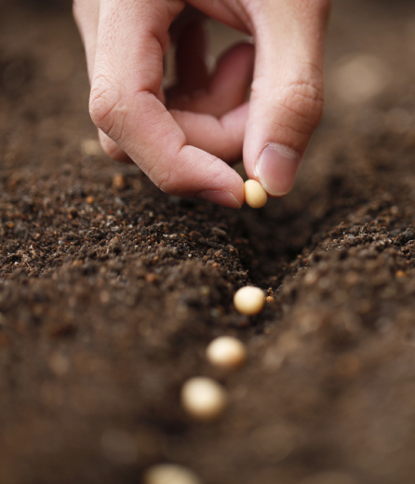
Direct Seed
Plant a seed as deep as the seed is big.

Slide 11
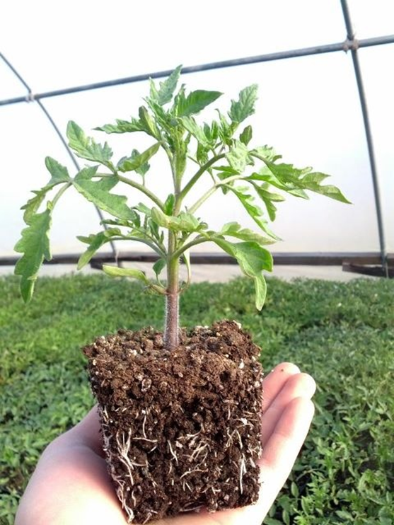
Transplants
Purchase or utilize saved seed and start plants in a greenhouse
Purchase transplants from local plant nurseries

Slide 12
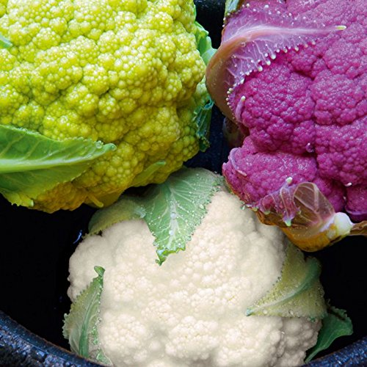
CAULIFLOWER
Grafitti
Kids love it

Slide 13
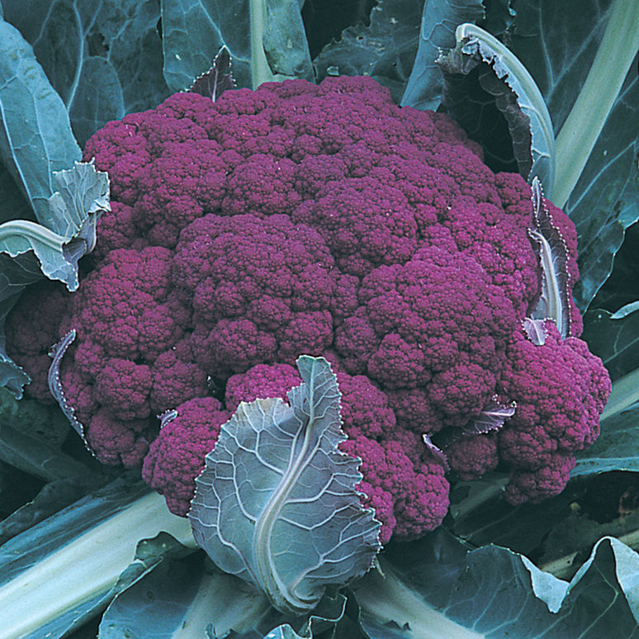
Graffiti Cauliflower
Hybrid
Kids love it
Grows well
in fall

Slide 14
Cleggs Plant Nursery
Louisiana Nursery
Harbs Oasis
Red Stick Farmers Market (Saturday weekly downtown Main & 5th)
Culture Makers Market (monthly last Sunday of month in spring, summer fall)

Slide 15
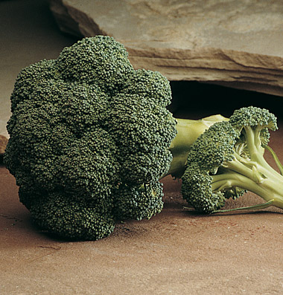
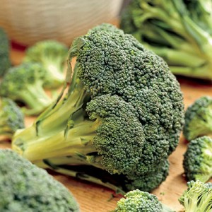
BROCCOLI
Arcadia Best cold tolerance for fall and
winter production.
A rugged, vigorous broccoli with mid-late maturity. Big plants with heavy, very firm, dark green, domed heads with a
unique "frosted" appearance. Tolerant of cold
stress. Excellent side-shoot
Pac Man
Early, high yielder whose side shoots perform well
even after the center is out.
A great performer in both yields and taste. 60 days to maturity. maturity.

Slide 16
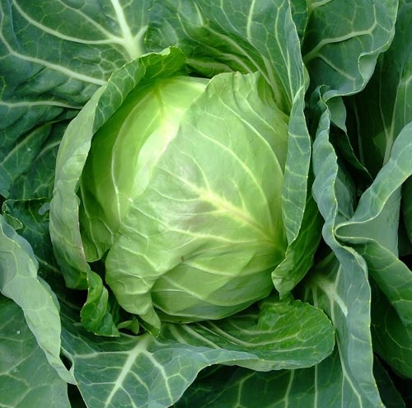
CABBAGE
Copenhagen
80 days — One of the largest early maturing
roundhead varieties. The solid, round heads
are six to eight inches in diameter and average
three to four pounds in weight. The texture is
tender and
crisp with a good, mild flavor. Keeps well.
Market variety.

Slide 17
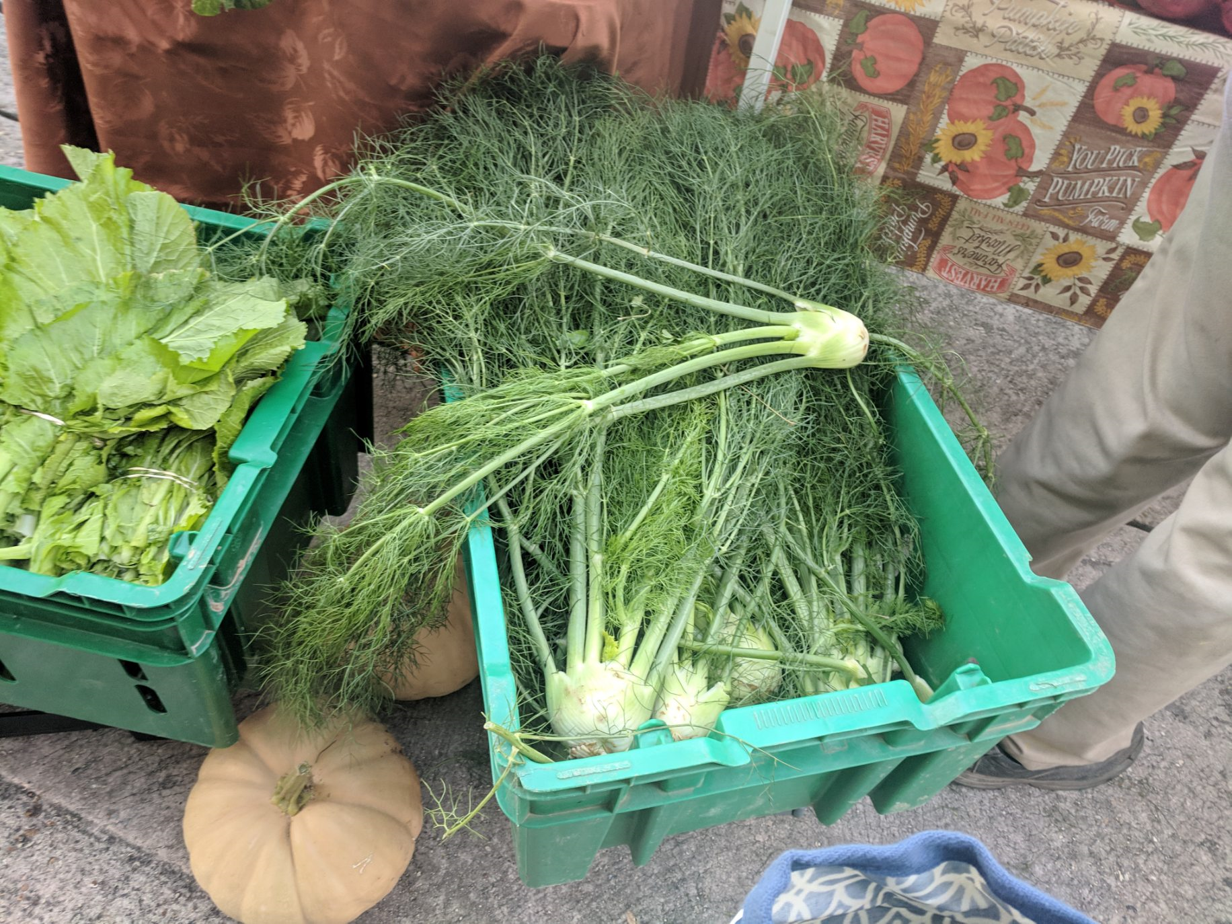
FENNEL

Slide 18
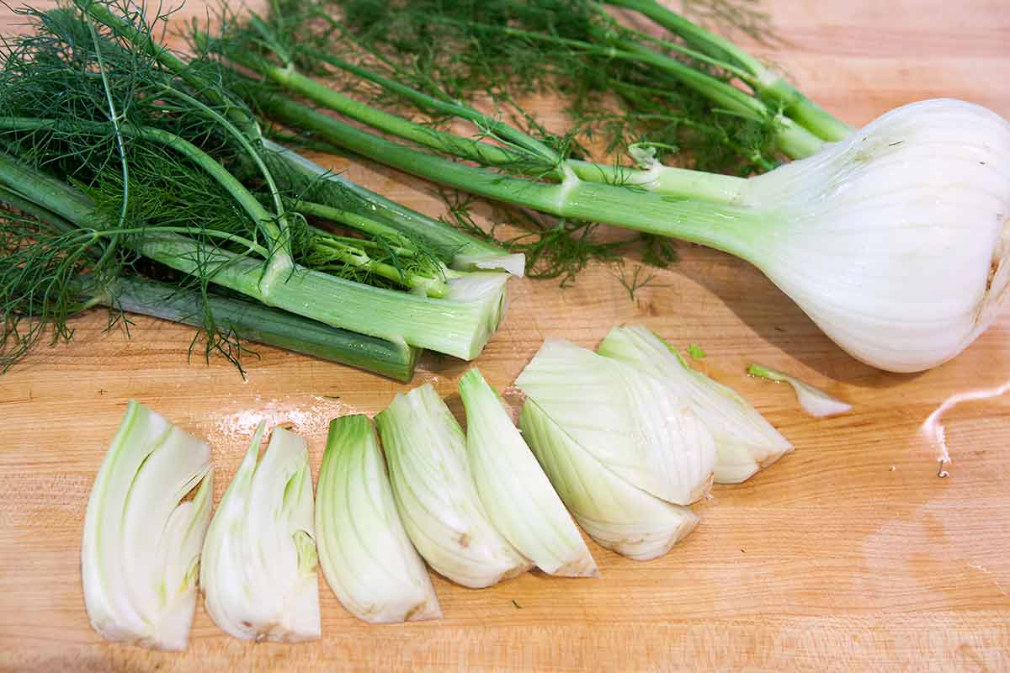

Slide 19
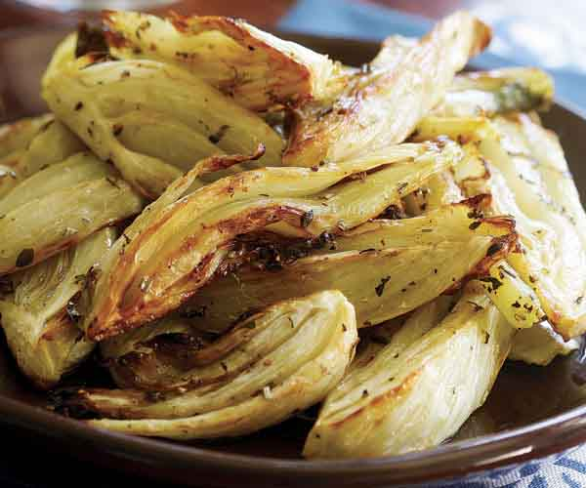
Roasted Fennel

Slide 20
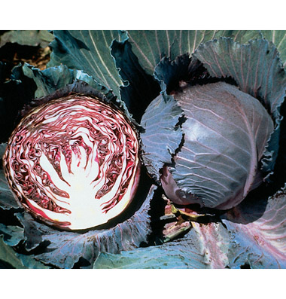
RED CABBAGE
Super Red
Early with excellent flavor
The round, medium-sized heads are well-wrapped, smooth and resist splitting. Flavor is superior for red cabbage: tender, crisp, and pleasantly peppery. Suitable for planting at close spacing to produce single-serving-sized mini cabbages.

Slide 21
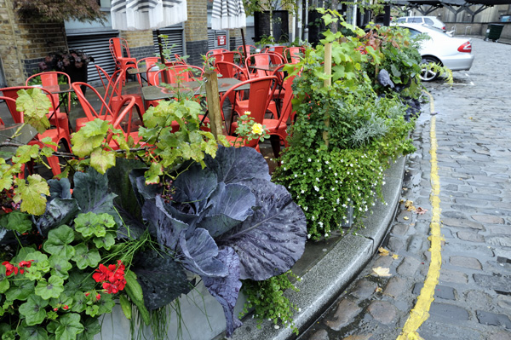
Landscape

Slide 22
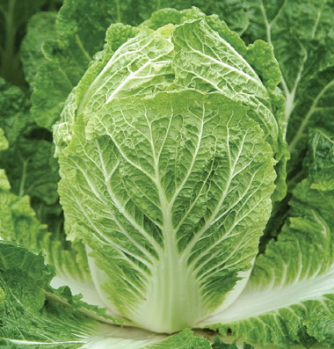
CHINESE CABBAGE
Bilko
12", darker green, and a couple of days later. Wide adaptability. Slow-bolting heads have a good, mild, sweet flavor. High resistance to club root and fusarium yellows. Organically grown.

Slide 23
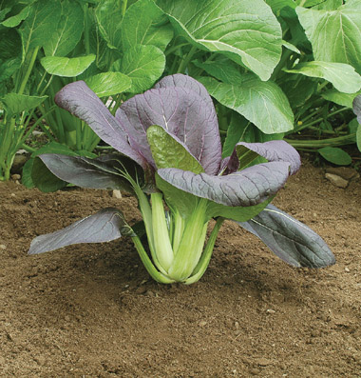
PAC CHOI
Red Choi
Excellent at micro green, baby leaf, and full size. Red Choi changes from dark green leaves with maroon veins at micro size to dark maroon leaves with green undersides and thin green petioles at full size (8-10").

Slide 24
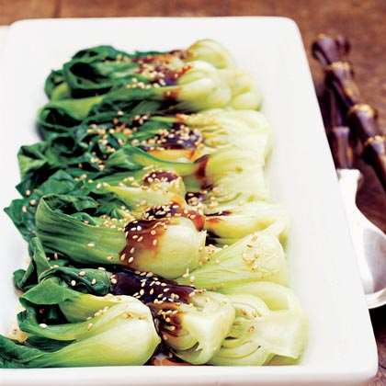

Slide 25
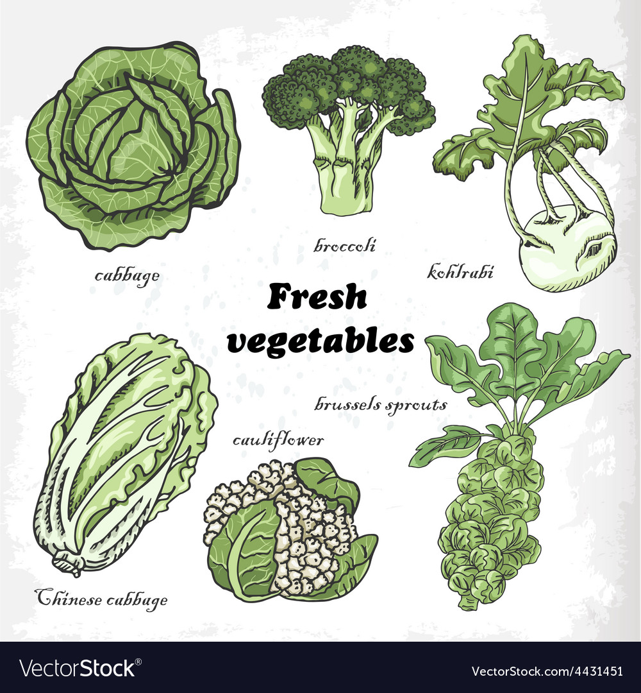

Slide 26
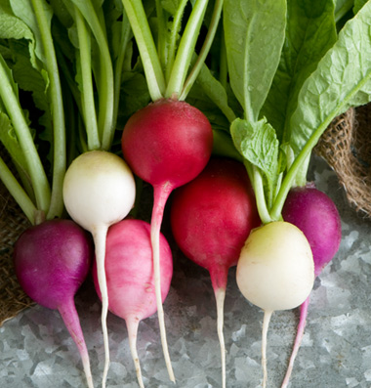
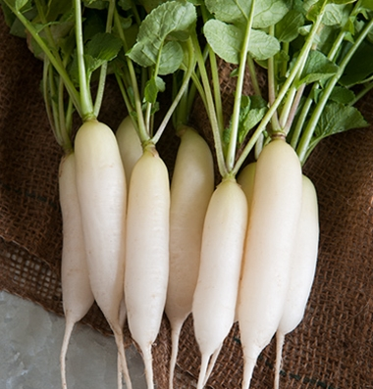
RADISH
Easter Egg White IcicleShort Top

Slide 27
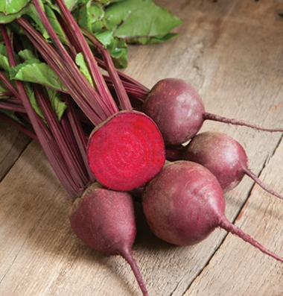
BEETS
Red Ace
The best all-around red beet.
Round, smooth, deep red roots
grow rapidly and uniformly. Sweet
and tender, even when older.
Medium-tall, red-veined greens
for bunching.

Slide 28
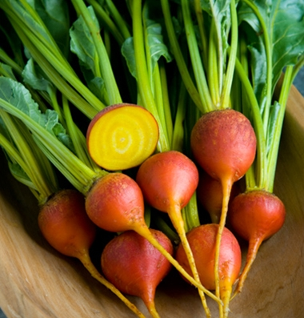
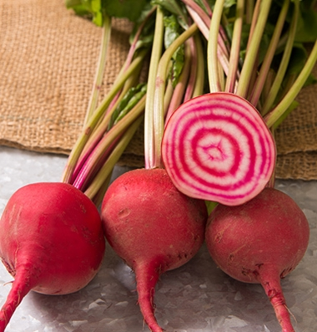
Touchstone Gold Chiogga

Slide 29
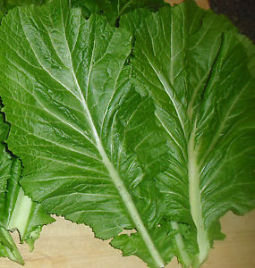
MUSTARD
Florida Broadleaf
Florida Broadleaf produces dark green leaves 16-22" tall that are flavorful and packed full of vitamins A, B, and C.
A Southern favorite for freezing orcanning. Extremely vigorous.
48 days.

Slide 30
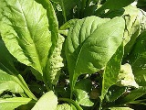
Tendergreen
Heirloom. One of the mildest mustards.
Tendergreen has smooth leaves and makes a fine spinach substitute, especially in the fall. Seeds germinate and grow quickly in late summer heat and mature to tender sweetness in cool weather. Thinnings are delicious as fresh snacks or in salads.

Slide 31
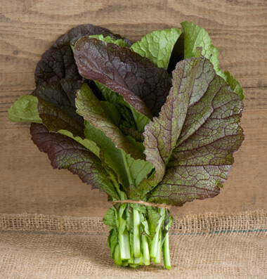
Red Giant Mustard
Popular "red" mustard from Japan.
Large, purple-tinted leaves. Mild mustard flavor. Larger, later, slightly darker, more narrow-stemmed, and 3-4 days slower bolting than Osaka Purple. Organically grown. When cooked looks and taste like traditional green mustard,

Slide 32
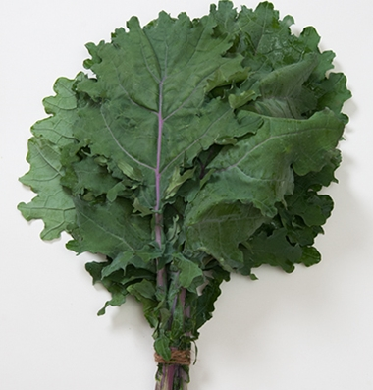
KALE
Red Russian
Smooth red leaves for baby leaf and bunching.
Stems are purple; leaves are flat, toothed, and dark green with purple veins. The plants mature medium-tall and leaves are tender compared to other kales. For salads and light cooking. NOTE: To extend storage life, dunk leaves in cold water post harvest.

Slide 33
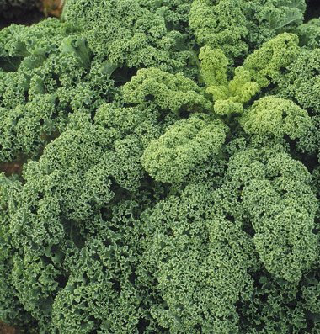
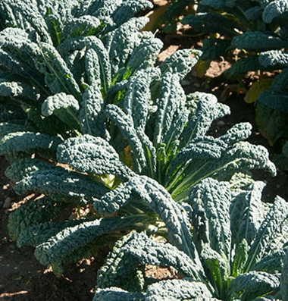
Winterbor Toscano
‘curly kale’ ‘black/dinosaur kale’

Slide 34
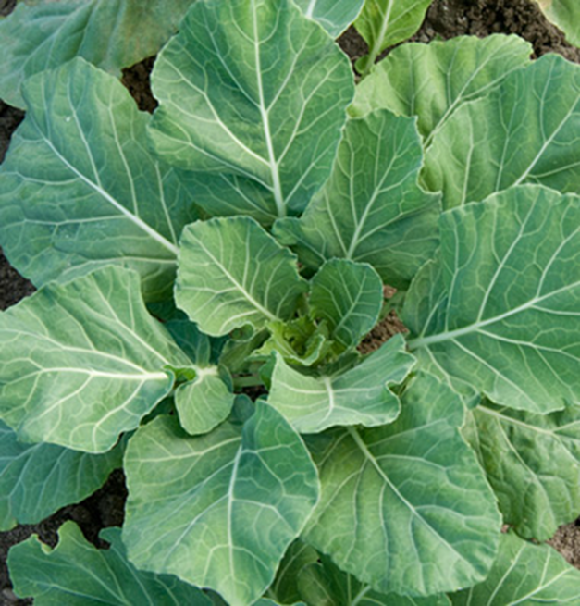
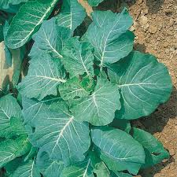
COLLARD
Georgia Champion
Slow Bolting Variety

Slide 35
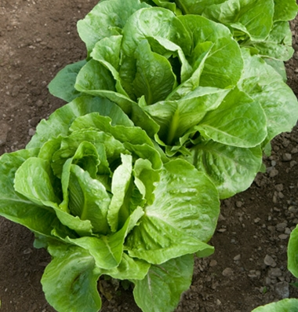
LETTUCE HEAD
Romaine Head lettuce
The large, heavy heads are dark green. Suitable for marketing as full heads or romaine hearts. Good, sweet flavor.

Slide 36
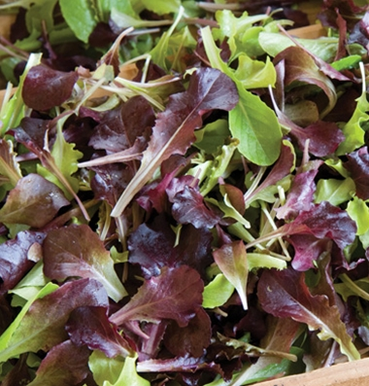
LEAF LETTUCE
Wildfire mix
This blend was created for high color contrast of the darkest red varieties paired with vibrant green varieties. Includes Green Oakleaf, Red Oakleaf, Green Romaine, Red Romaine, and Red Leaf lettuces.
(Johnnys Selected Seed)

Slide 37
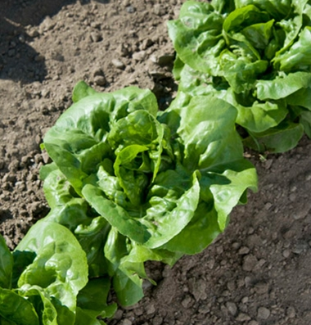
BIBB LETTUCE
Buttercrunch
Forms a small, open but tightly bunched, 6" rosette that is fan-shaped rather than round. Dark green leaves and small compact hearts that blanch to an appetizing yellow color. Crisp and sweet. Slow bolting.

Slide 38
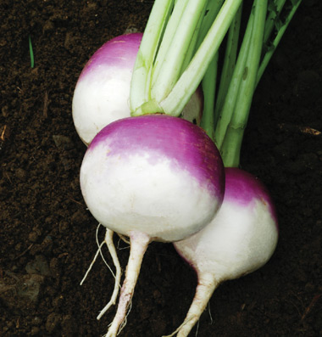
TURNIP
Purple Top
Selected strain of this traditional, Southern U.S. variety. Smooth, round roots, avg. 3-4" in diameter, are white below the soil line and bright purple above. Large, lobed greens. Organically grown.

Slide 39
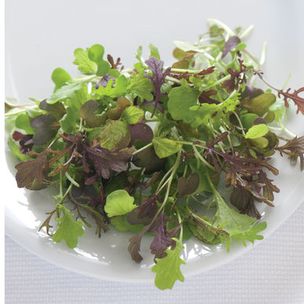
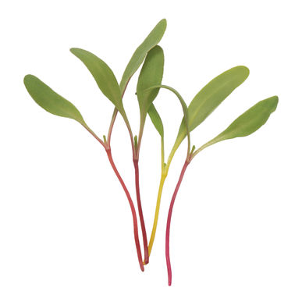
Micro greens !

Slide 40
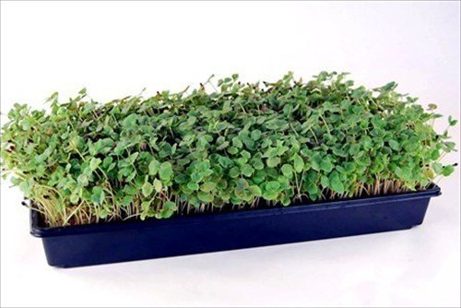

Slide 41
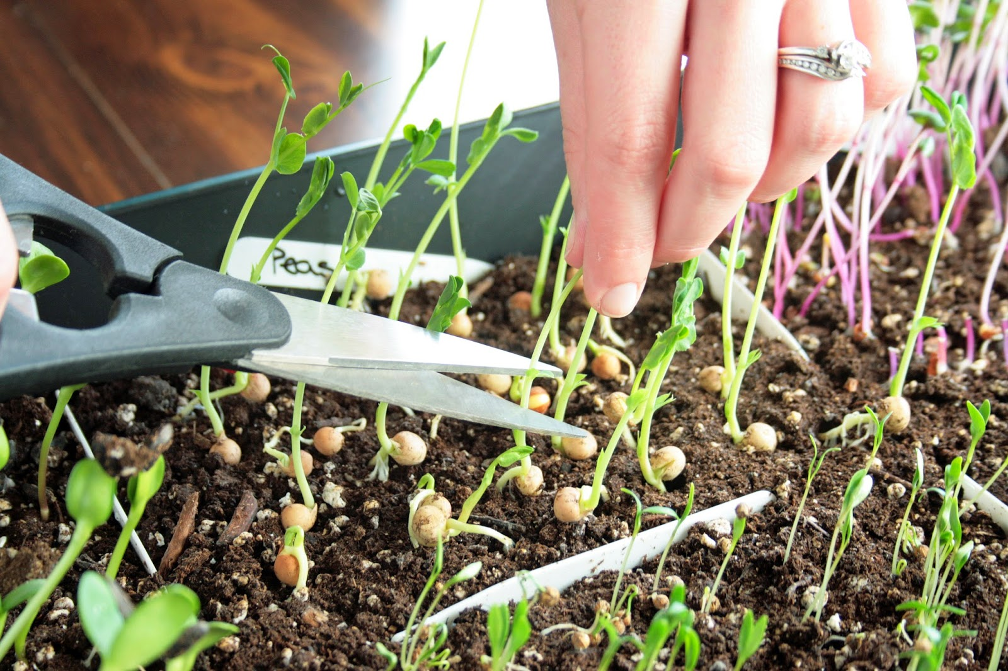

Slide 43
Discussion

